Slide 1

TRAIN TICKET MACHINE
Presented by :
Mohammad Ashiqur Noor (st117813)
Asian Institute of Technology
M.Eng in Microelectronics and Embedded Systems

Slide 2
CONTENTS
Introduction
Design & Operation
Inputs and Outputs
State Diagram
Simulated Results
Conclusion

Slide 3
INTRODUCTION
A train ticket machine is a kind of vending machine which dispenses tickets to the user in the form of paper or electronic ones.
This helps in reducing the need for the people at the counter who provides tickets.
The purpose of this project is to design a train ticket machine for the passengers who want to use the BTS system to travel inside Bangkok.
We are implementing this project using Verilog Hardware Description Language (HDL) and Moore Finite State Machine (FSM) approach.

Slide 4
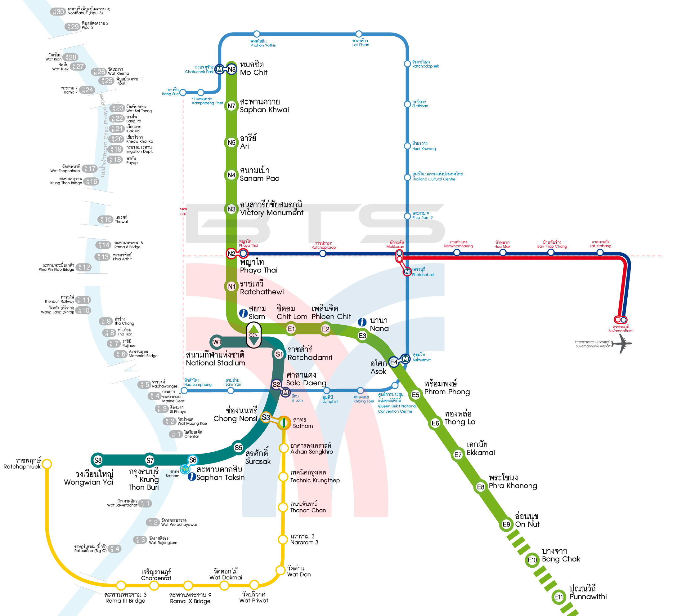
BTS MAP
Here we focus only on the green and dark green lines to make the ticket machine model.
The green line has 22 stations and the other one has 9 stations.
The customer can change line at Siam station.

Slide 5
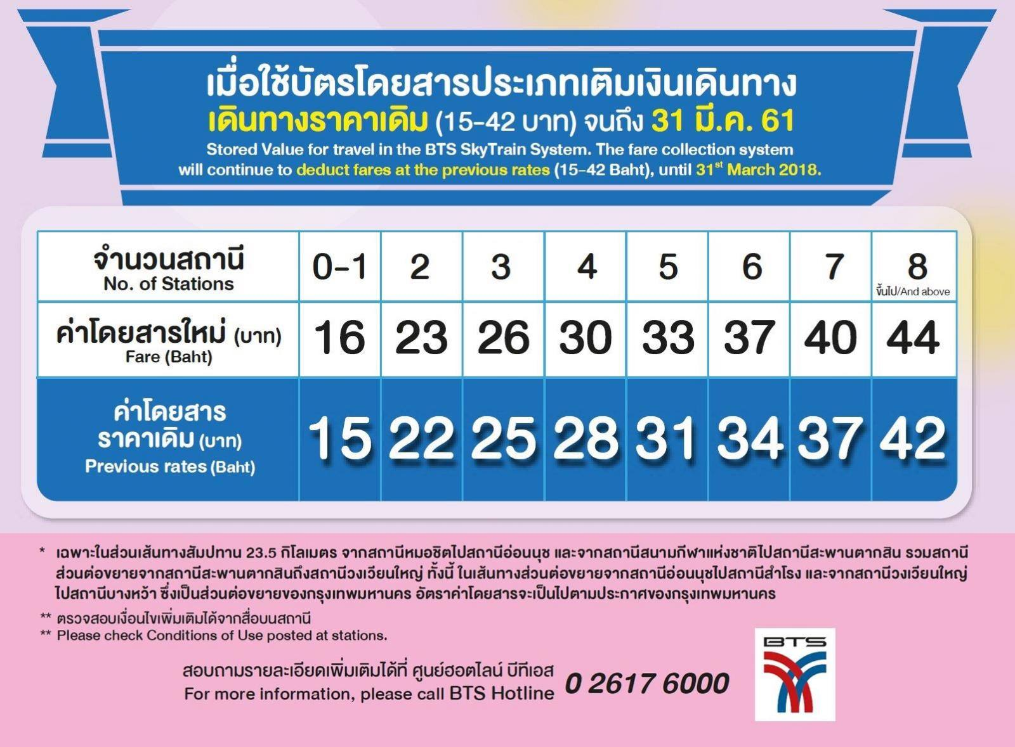
FARE COLLECTION SYSTEM

Slide 6
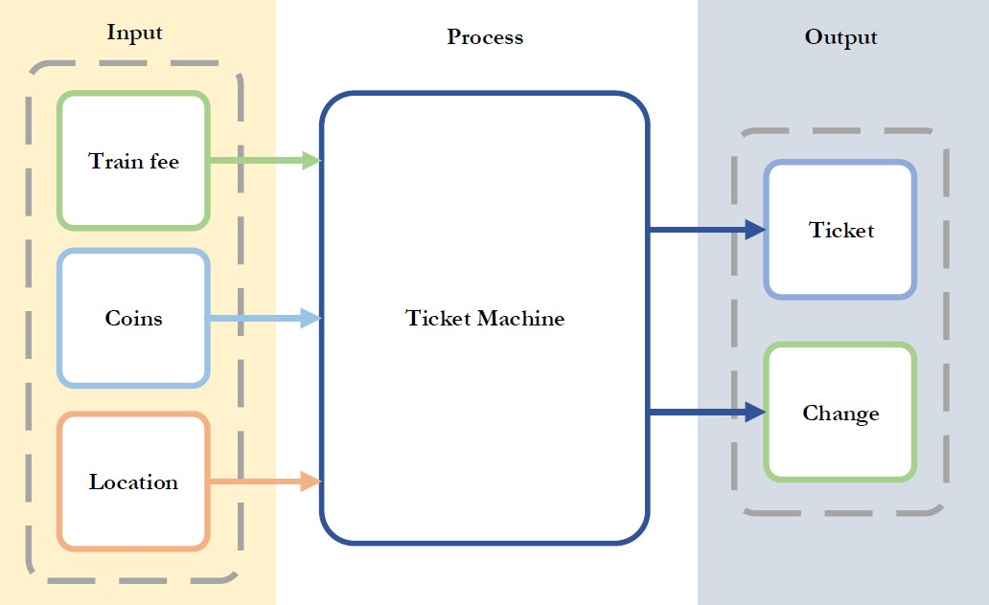
DESIGN

Slide 7
OPERATION
The passengers has to press the buttons corresponding to the desired locations.
The train fee has to be paid by inserting the coins.
The machine will then disperse the ticket and the change only if the passenger has given more money than required.
Then the machine will go back to its initial state waiting for the inputs of the next passenger.
If the user leave in the middle of the operation then another user can reset the machine and change if available will be returned back.

Slide 8
INPUTS & OUTPUTS
Inputs
Train Fee
Coins
Location (Hardcoded)
Outputs
Ticket
Change

Slide 9
MAIN STATE DIAGRAM
1
2
3
4
5
Scan train fee button
Display amount of money
Insert coin to the machine
Sum amount of money that user inserted
Subtraction of train fee with summation of money
10
9
8
6
RMM > 0
Clear the value of every registers
Give user the ticket
Upload data to ticket
RMM = 0
Compare remaining amount with “0” to find the change
7
RMM < 0
Change to user
Sensor detects user take the ticket

Slide 10
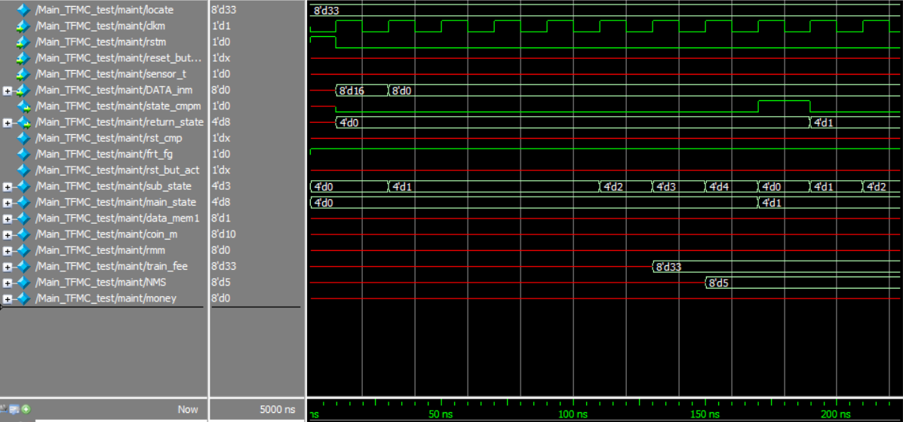
SIMULATED RESULTS
Main State Diagram output waveforms showing transition of main state and sub-states.

Slide 11
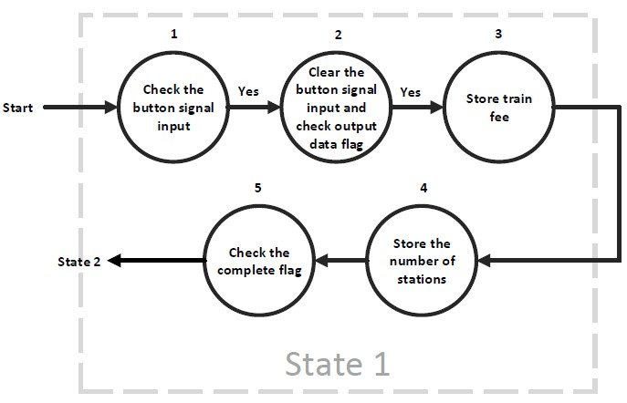
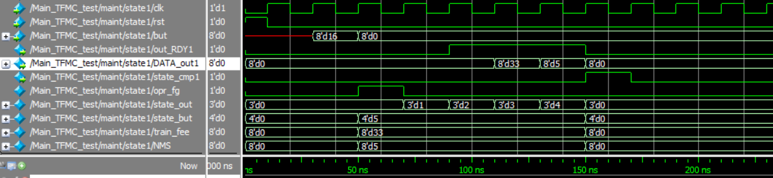
Output waveforms of State 1 showing button 5 when pressed and the train fee 33 baht with 5 stations needed to travel.

Slide 12
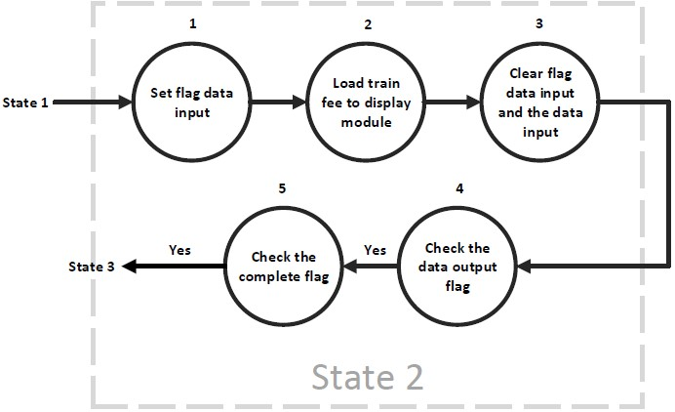
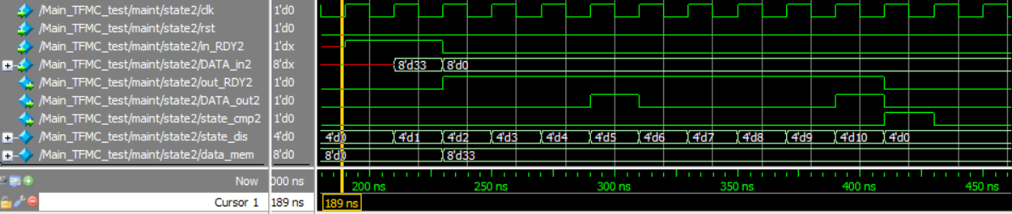
Output waveforms of State 2 showing the serial data of the amount of money to be displayed on the screen.

Slide 13
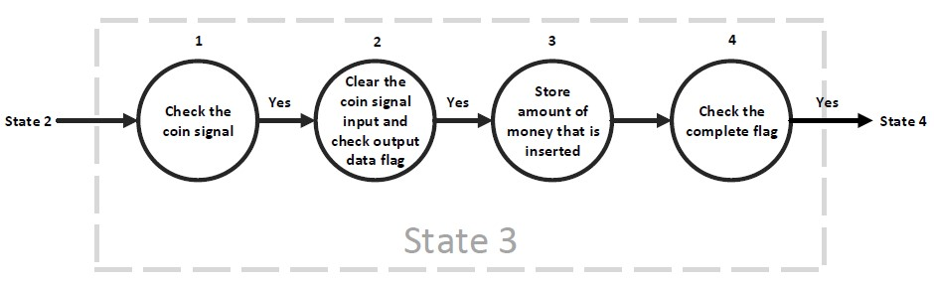
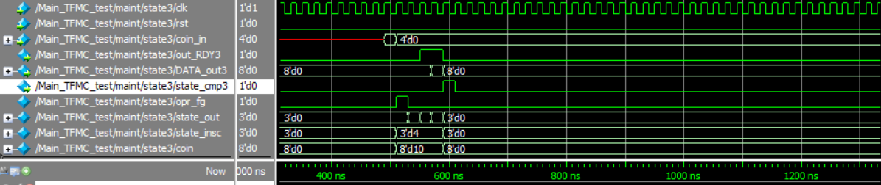
Output waveforms of State 3 showing the 10 baht coin inserted.

Slide 14
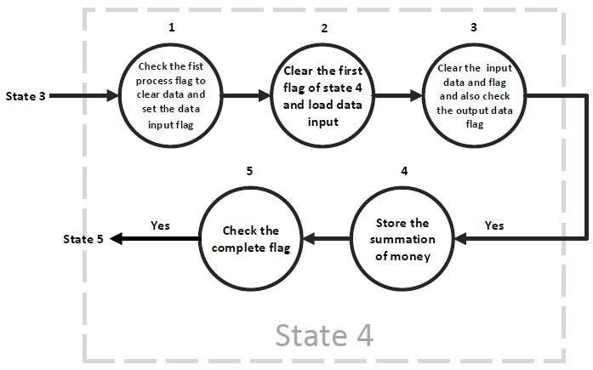
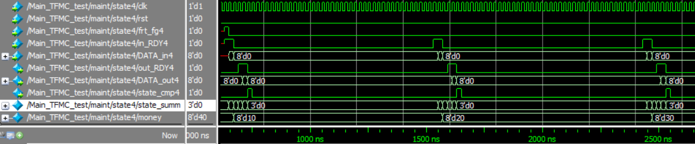
Output waveforms of State 4 showing the summation of coins when 10 baht is inserted multiple times.

Slide 15
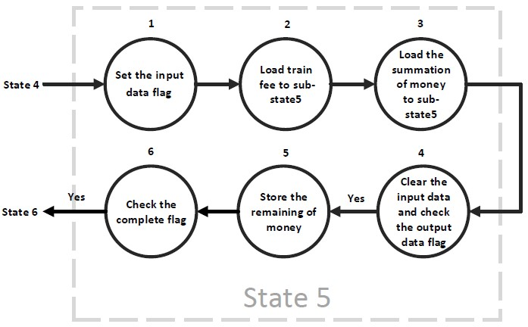
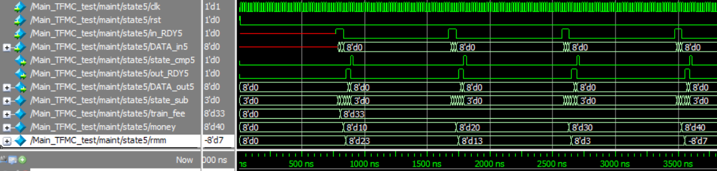
Output waveforms of State 5 showing the remaining money after subtracting with the train fee when 10 baht coin is inserted four times.

Slide 16
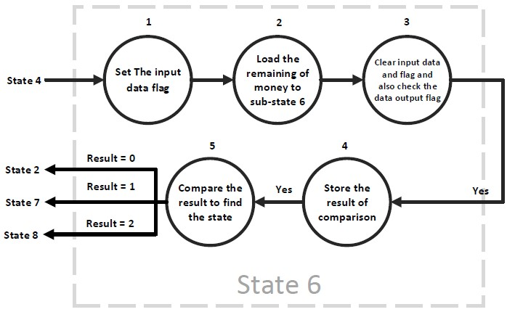
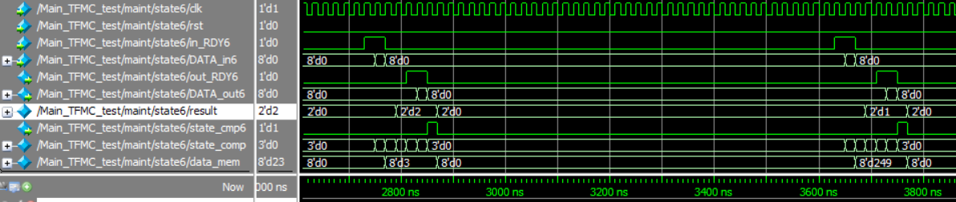
Output waveforms of State 6 showing the comparison to find out whether there is change or not.

Slide 17
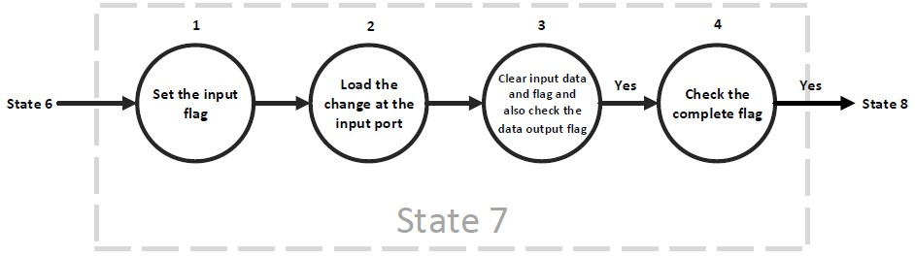
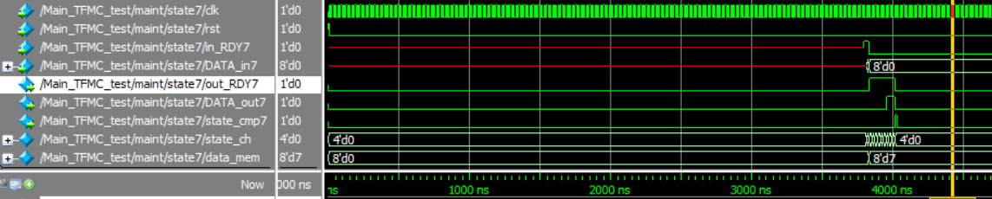
Output waveforms of State 7 showing the change of 7 baht given to the user.

Slide 18
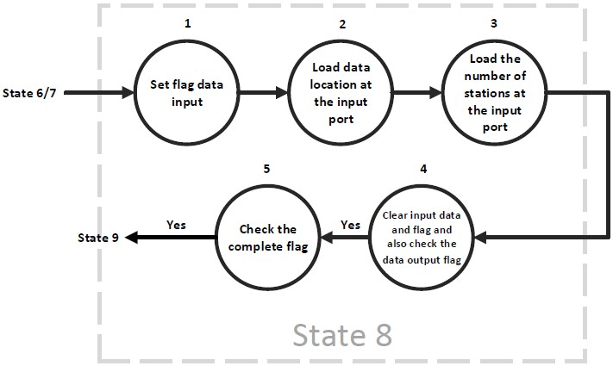
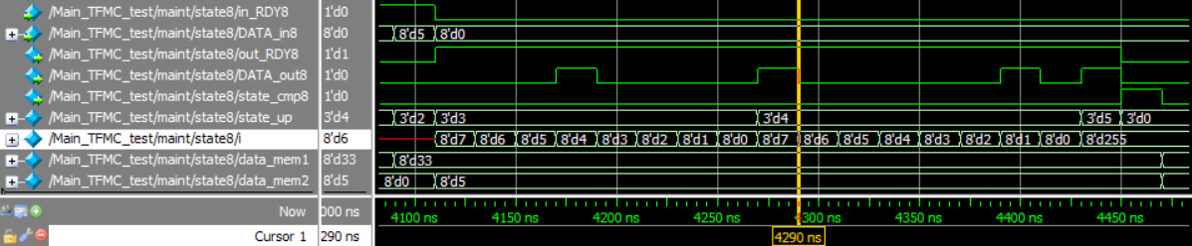
Output waveforms of State 8 showing the data (00100001) getting uploaded on ticket where the first 3 bits denote the line number and the last 5 bits denote the number of stations.

Slide 19
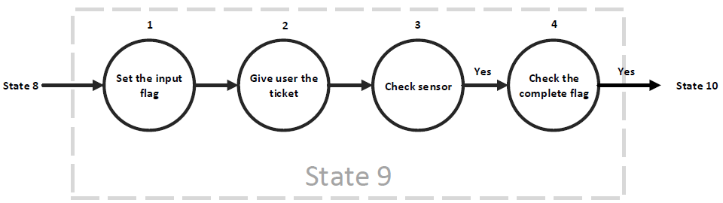
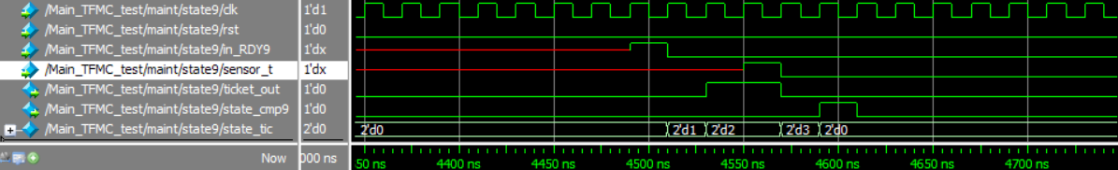
Output waveforms of State 9 showing that the user has taken the ticket by detecting it from a sensor.

Slide 20
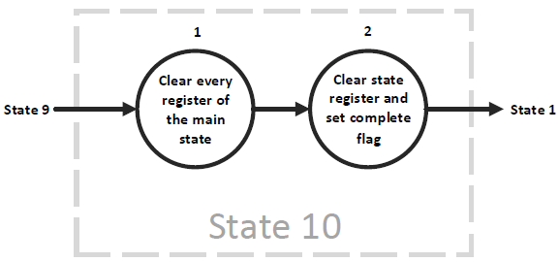
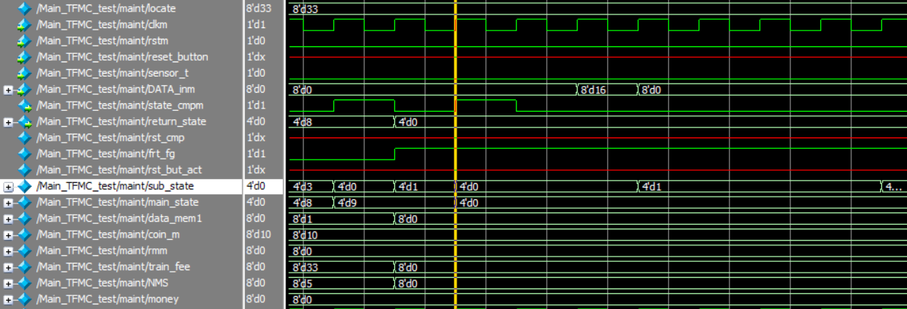
Output waveforms of State 10 which shows every registers of the main state is cleared.

Slide 21
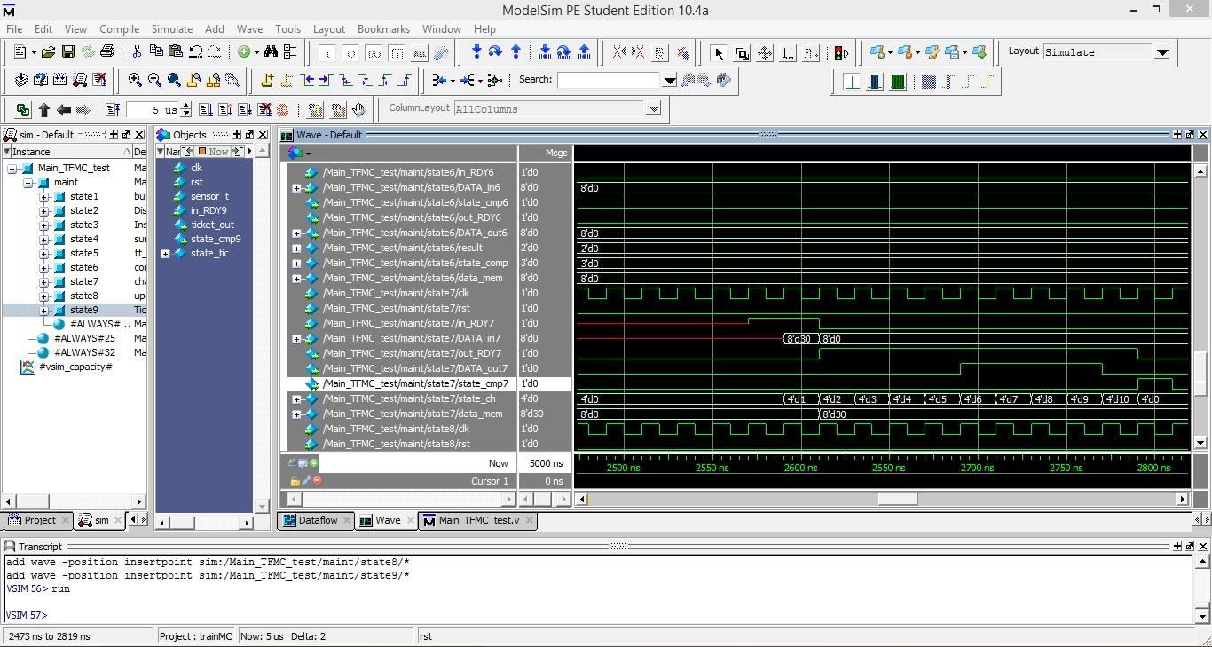
Output waveforms showing the change given to the user when reset button is pressed.

Slide 22
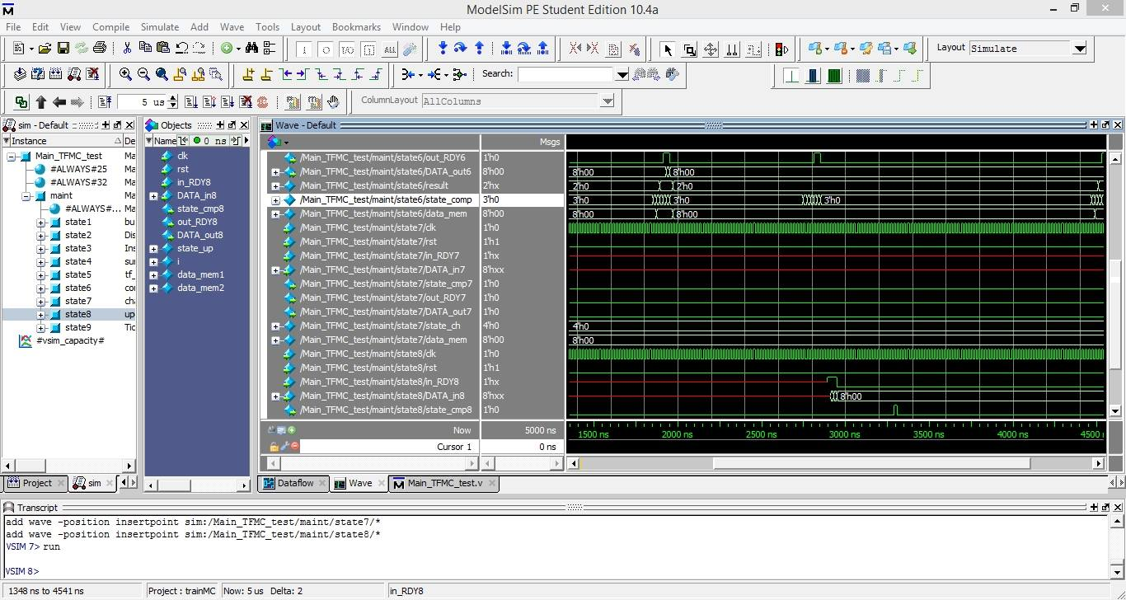
Output waveforms showing the result when the train fees is equal to the money inserted by the user.

Slide 23
CONCLUSION
The output waveforms are observed and verified.
Since the machine has achieved its objectives, it can be used in real world case scenario.
Thus our train ticket machine design is implemented Verilog Hardware Description Language (HDL) and Moore Finite State Machine (FSM) approach.

Slide 24
THANK YOU

